Slide 1

CISC 250 – Business Telecomm Networks
Application Layer Protocols
- World Wide Web & HTTP

Slide 2
Web and HTTP
First some jargon
Web page consists of objects
Object can be HTML file, JPEG image, Java applet, audio file,…
Web page consists of base HTML-file which includes several referenced objects
Each object is addressable by a URL
Example URL:
www.someschool.edu/someDept/pic.gif
host name
path name

Slide 3
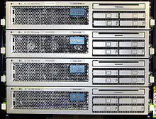
HTTP overview
HTTP: hypertext transfer protocol
Web’s application layer protocol
client/server model
client: browser that requests, receives, “displays” Web objects
server: Web server sends objects in response to requests
HTTP 1.0: RFC 1945
HTTP 1.1: RFC 2068
HTTP request
PC running
Explorer
HTTP response
HTTP request
Web
Server
(Apache
Microsoft IIS
…)
HTTP response
Mac running
Navigator

Slide 4
HTTP request message
two types of HTTP messages: request, response
HTTP request message:
ASCII (human-readable format)
request line
(GET, POST,
HEAD commands)
GET /somedir/page.html HTTP/1.1
Host: www.someschool.edu
User-agent: Mozilla/4.0
Connection: close
Accept-language:fr
(extra carriage return, line feed)
header
lines
Carriage return,
line feed
indicates end
of message

Slide 5
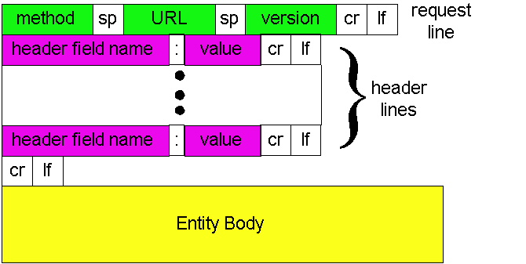
HTTP request message: general format

Slide 6
Method types
HTTP/1.0
GET
POST
HEAD
asks server to leave requested object out of response
HTTP/1.1
GET, POST, HEAD
PUT
uploads file in entity body to path specified in URL field
DELETE
deletes file specified in the URL field

Slide 7
Uploading form input
Post method:
Web page often includes form input
Input is uploaded to server in entity body
URL method:
Uses GET method
Input is uploaded in URL field of request line:
www.somesite.com/animalsearch?monkeys&banana

Slide 8
HTTP/2.0
Current HTTP version is 1.1
get /menu.html http/1.1
HTTP/2 specification was published as RFC 7540 in May 2015.
HTTP/2 allows the server to "push" content, that is, to respond with data for more queries than the client requested.
Multiplexing of requests, header compression, and prioritization of request.
https://en.wikipedia.org/wiki/HTTP/2

Slide 9
HTTP response message
status line
(protocol
status code
status phrase)
HTTP/1.1 200 OK
Connection close
Date: Thu, 06 Aug 1998 12:00:15 GMT
Server: Apache/1.3.0 (Unix)
Last-Modified: Mon, 22 Jun 1998 …...
Content-Length: 6821
Content-Type: text/html
data data data data data ...
header
lines
data, e.g.,
requested
HTML file

Slide 10
HTTP response status codes
In first line in server->client response message.
A few sample codes:
200 OK
request succeeded, requested object later in this message
301 Moved Permanently
requested object moved, new location specified later in this message (Location:)
400 Bad Request
request message not understood by server
404 Not Found
requested document not found on this server
505 HTTP Version Not Supported

Slide 11
Trying out HTTP (client side)
1. Telnet to your favorite Web server:
telnet udel.edu 80
Opens TCP connection to port 80
(default HTTP server port) at udel.edu.
Anything typed in sent
to port 80 at udel.edu
2. Type in a GET HTTP request:
GET /~jcao/ HTTP/1.1
Host: udel.edu
By typing this in (hit carriage
return twice), you send
this minimal (but complete)
GET request to HTTP server
3. Look at response message sent by HTTP server!

Slide 12
Downloading a Complex Webpage with Two Graphics Files
HTML Document
HTML Document
Browser
Webserver
Application
Client PC
2
Graphics
Files
Webserver
Download Requires 3
HTTP Request-Response Cycles;
Downloads HTML Page First
It has Tags to Identify Other Files
As
Displayed

Slide 13
Downloading a Complex Webpage with Two Graphics Files
Browser
Webserver
Application
Client PC
2
Graphics
Files
Webserver
Based on Tags in HTML Document,
Browser Requests Downloads of
Remaining Graphics or Other Files
Browser Renders Combined Webpage on Screen
As
Displayed

Slide 14


